Slide 1
Engineering Management Principals and Economics ENGR 301
Lecture 1A
Course Introduction
Introduction to Project Management
Dr C.J. Willis, CAPM, P.Eng
‹#›

Slide 2
Course Outline
Engineering Management
Organization Structure and types of Canadian Business Organizations
Project Delivery Systems
Contracts
Planning
Scheduling
Cost Estimating and Cost Control
Dr C.J. Willis, CAPM, P.Eng
‹#›

Slide 3
Course Outline
Economics
Time Value of Money
Interest and Equivalence
Present Worth Analysis
Annual Cash Flow Analysis
Rate of Return Analysis
Other Analysis Techniques
Inflation
Depreciation
Taxation
Dr C.J. Willis, CAPM, P.Eng
‹#›

Slide 4
Lecture 1A – Introduction to Project Management
Learning Objectives
learners will:
Understand what is a project
Understand what is project management
Understand who is a project manager
Be introduced to the project management objectives
Be introduced to project management knowledge areas
Be introduced to project phases and life cycle
References
PMI. 2010. Project Management Body of Knowledge, 4th Edition
Dr C.J. Willis, CAPM, P.Eng
‹#›

Slide 5
What is a project?*
A project is a temporary endeavor undertaken to create a unique product, service or result
Dr C.J. Willis, CAPM, P.Eng
‹#›

Slide 6
What is a project?
Temporary
Definite beginning and definite end
End is reached when:
Project objectives are achieved
It’s clear that project objectives cannot be met
Temporary in no way means short.
A project can be from a few days to as much as 5 years long
Dr C.J. Willis, CAPM, P.Eng
‹#›

Slide 7
What is a project?
Unique
Has not been done before
Even if projects are identical
(E.g. Office Buildings: owner, location, design…etc)
Dr C.J. Willis, CAPM, P.Eng
‹#›

Slide 8
What is Project Management? *
Project management is the application of knowledge, skills, tools, and techniques to project activities to meet project requirements.
Project management is accomplished through the use of processes such as: initiating, planning, executing, controlling, and closing altogether known as PROJECT LIFE CYCLE.
Dr C.J. Willis, CAPM, P.Eng
‹#›

Slide 9
Project Life Cycle*
All projects can be mapped into the following project life cycle structure:
Starting the project (Initiation)
Organizing and preparing (Planning)
Carrying out the work (Execution)
Closing the project (closure)
Dr C.J. Willis, CAPM, P.Eng
‹#›

Slide 10
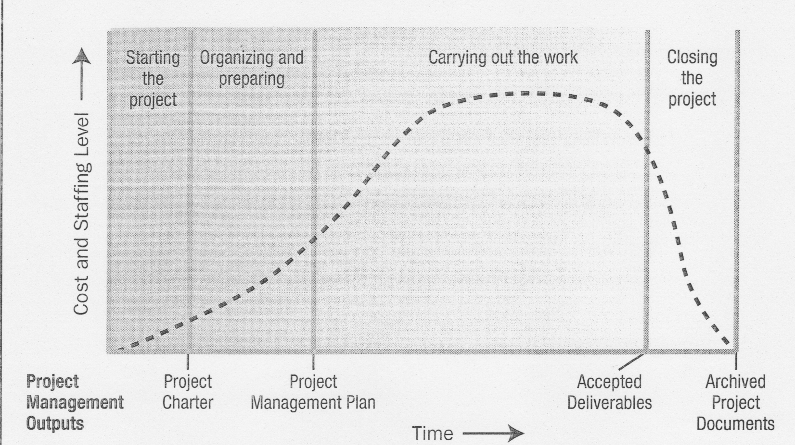
Project Life Cycle*
Typical Cost and Staffing Levels across the Project Life Cycle
Dr C.J. Willis, CAPM, P.Eng
‹#›

Slide 11
Project Stakeholders
Key Stakeholders
Project Manager – person responsible for managing the project
Customer/user – person or organization that will use the project’s product
Performing organization – the enterprise whose employees are mostly involved in doing the work of the project
Project team members – the group that is performing the work of the project
Dr C.J. Willis, CAPM, P.Eng
‹#›

Slide 12
Project Stakeholders
Key Stakeholders
Project Management Team – the members of the project team who are directly involved in project management activities
Sponsor – the person or group that provides the financial resources for the project
Influencers – people or group that are not directly related to the acquisition or the use of the project’s product
Dr C.J. Willis, CAPM, P.Eng
‹#›

Slide 13
Influence of Project Stakeholders
Project stakeholders may have either a positive or negative influence on the project
Positive stakeholders are those who would normally benefit from a successful outcome from the project
Negative stakeholders are those who see negative outcomes from the project’s success
Dr C.J. Willis, CAPM, P.Eng
‹#›

Slide 14
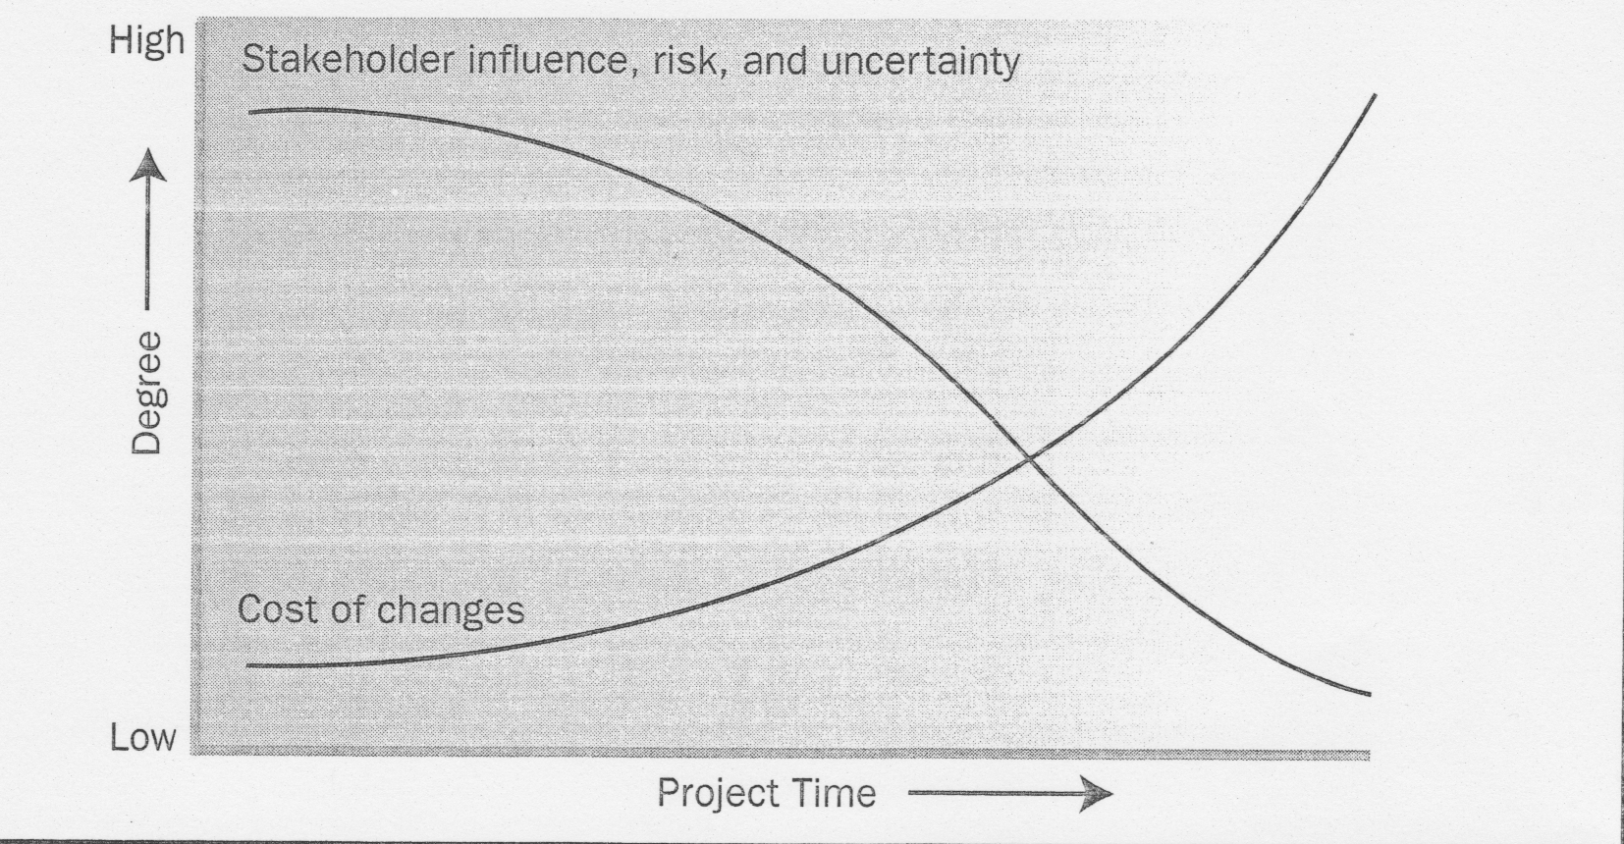
Project Life Cycle*
Impact of Variable based on Project Time
Dr C.J. Willis, CAPM, P.Eng
‹#›

Slide 15
Who is a Project Manager?*
The project manager is the person responsible for accomplishing the project objectives
Dr C.J. Willis, CAPM, P.Eng
‹#›

Slide 16
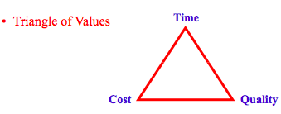
Project Management Objectives *
To deliver a project on target the following objectives must be met:
Time, Cost, Quality
Dr C.J. Willis, CAPM, P.Eng
‹#›

Slide 17
Project Management Knowledge Areas
Project Integration Management
Project Scope Management
Project Time Management
Project Cost Management
Project Quality Management
Project Human Resource Management
Project Communications Management
Project Risk Management
Project Procurement Management

Slide 18
Project Management Knowledge Areas
Project Integration Management(Coordination)
Processes required to ensure proper coordination of various project elements and include:
Project Plan Development
Project Plan Execution
Integration Change Control
Dr C.J. Willis, CAPM, P.Eng
‹#›

Slide 19
Project Management Knowledge Areas
Project Scope Management
Processes required to ensure that the project includes all the work required and include:
Initiation
Scope Planning
Scope Definition
Scope Verification
Scope Change Control
Dr C.J. Willis, CAPM, P.Eng
‹#›

Slide 20
Project Management Knowledge Areas
Project Time Management
Processes required to ensure timely completion of the project and include:
Activity definition
Activity sequencing
Activity duration estimation
Schedule development
Schedule control
Dr C.J. Willis, CAPM, P.Eng
‹#›

Slide 21
Project Management Knowledge Areas
Project Cost Management
Processes required to ensure the project is completed within the planned budget and include:
Resource planning
Cost estimating
Cost budgeting
Cost control
Dr C.J. Willis, CAPM, P.Eng
‹#›

Slide 22
Project Management Knowledge Areas
Project Quality Management
Processes required to ensure the project satisfies the needs for which it was undertaken and includes:
Quality Planning
Quality Assurance
Quality Control
Dr C.J. Willis, CAPM, P.Eng
‹#›

Slide 23
Project Management Knowledge Areas
Project Human Resource Management
Processes required to ensure most effective use of people involved and includes:
Organizational Planning
Staff Acquisition
Team Development
Dr C.J. Willis, CAPM, P.Eng
‹#›

Slide 24
Project Management Knowledge Areas
Project Communications Management
Processes required to ensure timely and appropriate handling of project information and includes:
Communications planning
Information distribution
Performance reporting
Administrative closure of the project (after completion)
Dr C.J. Willis, CAPM, P.Eng
‹#›

Slide 25
Project Management Knowledge Areas
Project Risk Management
Processes concerned with identifying, analyzing, and responding to project risk and includes:
Risk Management Planning
Risk Identification
Qualitative Risk Analysis
Risk Response Planning
Risk Monitoring and Control
Dr C.J. Willis, CAPM, P.Eng
‹#›

Slide 26
Project Management Knowledge Areas
Project Procurement Management
Processes required to acquire goods and services from outside the organization and includes:
Procurement planning
Solicitation planning
Solicitation
Source selection
Contract administration
Contract closeout
Dr C.J. Willis, CAPM, P.Eng
‹#›

Slide 27
Project Phases
Inception: by investor/owner – where the project is first visualized
Planning and Definition: by investor/owner – rough estimate of the project duration, budget and plan are developed
Design: by architect/engineer – components of the project are designed
Procurement and Production: by contractor – purchasing necessary goods (construction)
Start up and Commissioning: by contractor – where project is delivered to the owner
Dr C.J. Willis, CAPM, P.Eng
‹#›

Slide 28
Lecture 1B
Project Organization Structure
Dr C.J. Willis, CAPM, P.Eng
‹#›

Slide 29
Organization Structure
A structure through which the manager and the subordinates divide the two types of information among them, is called the organization structure.

Slide 30
Organizational Structure
Projects are typically part of an organization that is larger than the project
Example: Corporations, Government Agencies, Health Care Institutions, International Bodies, Professional Associations, etc.
Projects are influenced by their organizations or organizations that set them up
Dr C.J. Willis, CAPM, P.Eng
‹#›

Slide 31
Macro and Micro View
The type of information that we are exposed to, depends drastically on our “point of view” or standpoint
If we stand close to an object, we see the details .But we cannot see the big picture. On the other hand, if we stand far from the object we see the big picture but we overlook the details.

Slide 32
Trade -off
So there is a Trade-off between Macro and Micro view
Organization Theory can be explained by the trade-off between Macro and Micro viewpoint
Coordination between several jobs require the manager to stand away from all of them.
Therefore the manager will get the big picture and overlook the details as shown in Fig 1.

Slide 33
Macro view
Command
Restaurant
Manager
Information
Kitchen
Waiters
Procurement
Entertainer
Micro view
Organization Pyramid
Fig. 1

Slide 34
Types of Organizational Structures
Functional
Projectized
Matrix
Weak
Balanced
Strong
Dr C.J. Willis, CAPM, P.Eng
‹#›
Notes:
‹#›

Slide 35
Functional Organization
Project is divided into segments and assigned to relevant functional areas and/or groups within functional areas. The project is coordinated by functional and upper level management
Moselhi 1997
Dr C.J. Willis, CAPM, P.Eng
‹#›

Slide 36
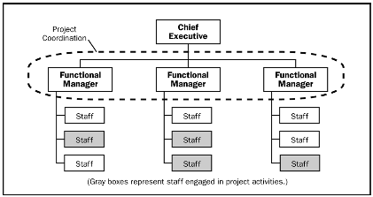
Functional Organization
Dr C.J. Willis, CAPM, P.Eng
‹#›

Slide 37
Functional Organization
Hierarchy where each employee has one clear superior (unity of command)
Staff grouped by specialty
Perceived project scope is limited to boundaries of each function (e.g. engineering working independently of manufacturing department)
Dr C.J. Willis, CAPM, P.Eng
‹#›

Slide 38
Functional Organization
Strengths include:
High stability
High professional standard
Incorporation of latest technology
Excellent corporate memory (Archiving and filing)
Tightest discipline control
Dr C.J. Willis, CAPM, P.Eng
‹#›

Slide 39
Functional Organization
Weaknesses include:
Poor communication across functional areas
Low adaptability
Minimum appreciation of overall project objectives
Overly rigid operating rules
Resistance to change
Dr C.J. Willis, CAPM, P.Eng
‹#›

Slide 40
Functional Organization
Works best when design and construction don’t overlap
Requires skilled people-oriented managers, who can avoid internal conflict with other functional groups
Dr C.J. Willis, CAPM, P.Eng
‹#›

Slide 41
Sample Functional Organizations
Universities
Government
Armed Forces
Dr C.J. Willis, CAPM, P.Eng
‹#›

Slide 42
Projectized Organization
A project manager is in charge of a project team composed of a core group of personnel from different functional areas &/or groups assigned on a full time basis. The functional managers have no formal involvement
Moselhi 1997
Dr C.J. Willis, CAPM, P.Eng
‹#›

Slide 43
Projects
Project A
Project B
Accountant
Engineer
Buyer
Accountant
Engineer
Buyer
Projectized Organization: Possess their own resources to perform their tasks.

Slide 44
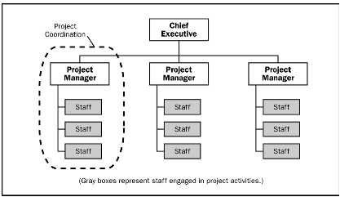
Projectized Organization
Dr C.J. Willis, CAPM, P.Eng
‹#›

Slide 45
Projectized Organization
Most of the organization’s resources are involved in the project
Project managers have a great deal of independence and authority
Projectized organizations often have organizational units called departments
but these groups either report directly to the project manager or provide support services to the various projects
Dr C.J. Willis, CAPM, P.Eng
‹#›

Slide 46
Matrix Organization
A hybrid of functional & projectized attempting to preserve the strong point of each
Strong matrix organization resembles projectized organization
max power to project managers
Weak matrix organization resembles functional organization
max. power to functional managers
Dr C.J. Willis, CAPM, P.Eng
‹#›

Slide 47
Matrix organization is a hybrid of Functional and Project organization
Project organization
100
Weaker
Matrix Organization
(Balanced)
50
Functional organization
0
50
100

Slide 48
Matrix organization
 | Accounting Dept. | Engineering Dept. | Logistics Dept.
Project1 | Accountant | Engineer | Buyer
Project2 | Accountant | Engineer | Buyer
Project 3 | Accountant | Engineer | Contractor

Slide 49
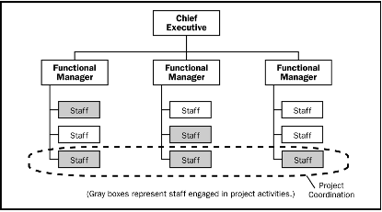
Weak Matrix Organization
Dr C.J. Willis, CAPM, P.Eng
‹#›

Slide 50
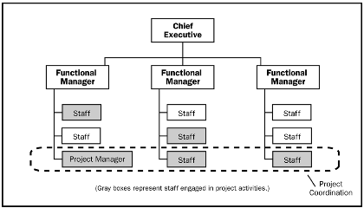
Balanced Matrix Organization
Dr C.J. Willis, CAPM, P.Eng
‹#›

Slide 51
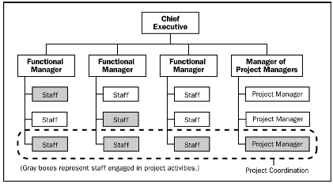
Strong Matrix Organization
Dr C.J. Willis, CAPM, P.Eng
‹#›

Slide 52
Matrix Organization
Project responsibilities such as scope, cost & schedule are the responsibility of the project manager
Functional objectives such as quality assurance, design standards and internal company policies are the responsibility of the functional manager
Dr C.J. Willis, CAPM, P.Eng
‹#›

Slide 53
Matrix Organization
Advantages
Combines functional strength with the advantage of project-oriented team
Fosters excellent climate for developing project managers
Retains access to corporate memory
Dr C.J. Willis, CAPM, P.Eng
‹#›

Slide 54
Matrix Organization
Disadvantages
Difficulty in precisely defining accountability of both functional and project managers
Violation of unity command principle (hierarchical organization principle that no subordinate should report to more than one boss)
Strongest managers often dominate
Highest overall management and administrative cost
Dr C.J. Willis, CAPM, P.Eng
‹#›

Slide 55
Organizational Structure’s Influence on Projects
 | Functional | Matrix |  |  | Projectized
Project Characteristics |  | Weak Matrix | Balanced Matrix | Strong Matrix
Project Manager’s Authority | little or non | Limited | Low to moderate | Moderate to High | High to almost total
Resource Availability | little or non | Limited | Low to moderate | Moderate to High | High to almost total
Who Controls the Project Budget | Functional Manager | Functional Manager | Mixed | Project Manager | Project Manager
Project Manager’s Role | Part Time | Part Time | Full time | Full time | Full time
Project Management Administrative Staff | Part Time | Part Time | Part Time | Full time | Full time
Dr C.J. Willis, CAPM, P.Eng
‹#›

